Slide 1
Austrian Development Agency
DCED Annual Meeting Washington D.C. June 2024
Gottfried Traxler
Head for Private Sector and Development

Slide 2
Agenda
ADA´s Business Partnership Program
Reforming the Business Partnership Program of ADA
Call for Proposals: Business Partnership Challenge 2024
Working together with the Austrian Development Bank

Slide 3
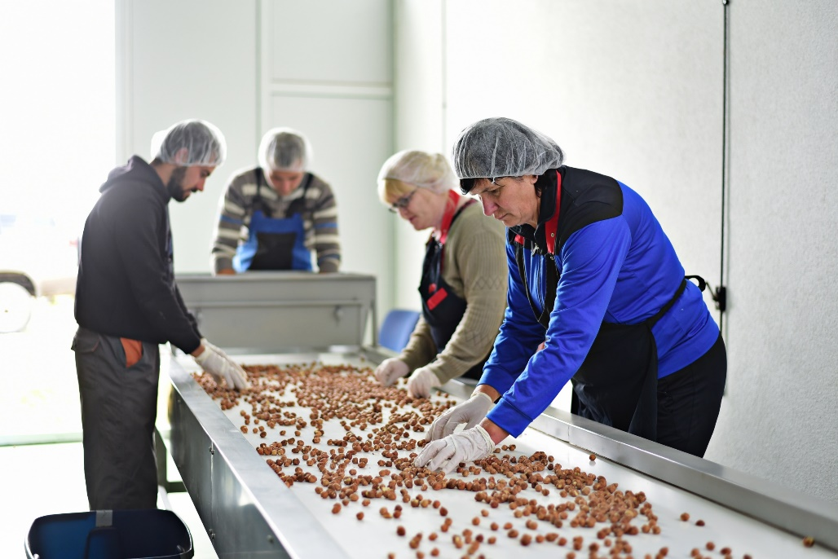
Business Partnership Program
3

Slide 4


The Austrian Development Cooperation (OEZA)
Austrian Federal Ministry for European and International Affairs (BMEIA)
Section VII
Austrian Development Agency (ADA)
= the OEZA agency
4

Slide 5
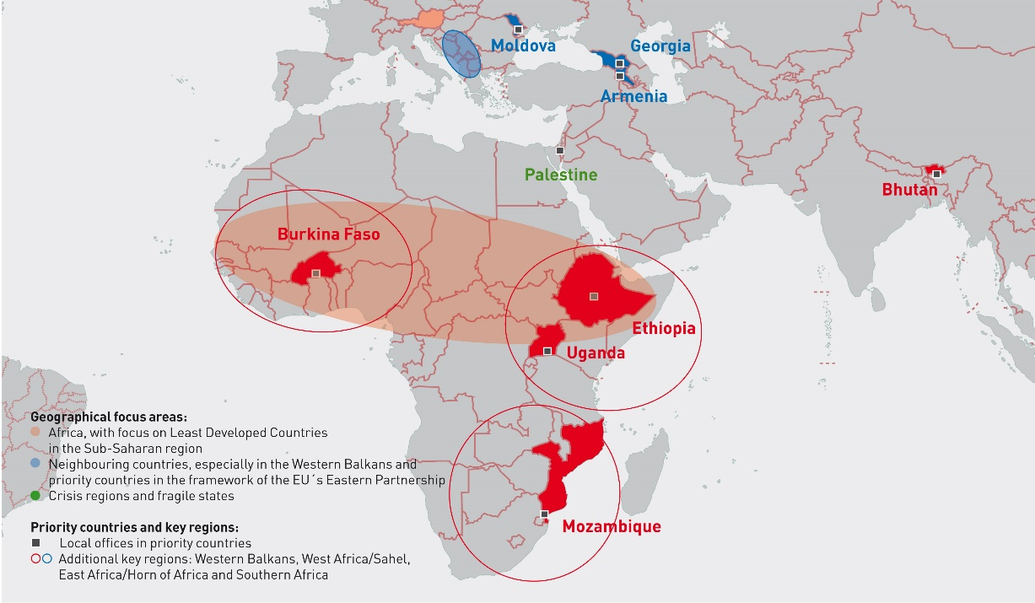
Geographical focus areas

Slide 6
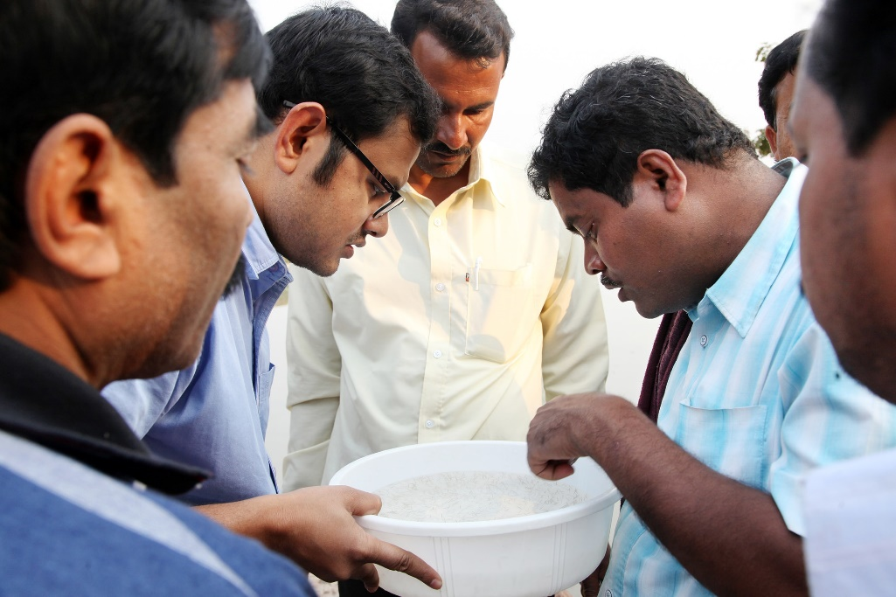
Figures about our work:
Between 2005 and 2023
started 222
business partnership
projects
with a
funding of EUR 60 million.

Slide 7
Priorities
Strengthening the local private sector in the Global South (PSD)
Mobilizing the potential of Austrian and European enterprises for development cooperation (PSE)
Notes:
Mission & Vision-Statement

Slide 8
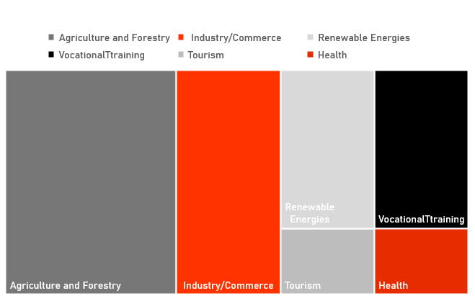
Sectors 2005-2023
8

Slide 9
Project Regions 2005-2023

Slide 10
Reforming the Business Partnership Program
Guiding Principles
Call for Proposals
Optimizing funding procedures
10

Slide 11
Guiding Principles for Business Partnerships
Mobilize Austrian / European companies for engagement in the Global South
Encourage companies that are active or would like to be active in the Global South
to define their role in the local market system of the target country and
to make their contribution to sustainable and inclusive development within the framework of a business partnership.

Slide 12
Guiding Principles of the Business Partnerships
2. Invest in opportunities, comply with standards, actively manage quality
In order to exploit opportunities, we accept certain uncertainties and risks.
We make our quality standards clear and promote projects that meet them.
We prevent problems through an active management approach in order to maximize effectiveness and minimize the likelihood of negative effects.

Slide 13
Guiding Principles of the Business Partnerships
3. Communicate efficiently, clearly and bindingly
We strive to make communication efficient and keep administrative costs low through standardization - well-prepared information material, process descriptions, standard formats and templates, etc.
Feedback to applicants and funding recipients is formulated in a way that is easy for them to understand, relates to comprehensible criteria and remains valid.

Slide 14
Reforming the Business Partnership Program
Guiding Principles
Call for Proposals
Optimizing funding procedures
14

Slide 15
Business Partnership Challenge 2024
What is it about?
Who can apply?
The Business Partnership Challenge 2024 is a call for proposals that follows the principles and objectives of ADA's Business Partnership Program. First round concluded on the 3rd of June. Will be held annually.
Any company headquartered in the European Economic Area (EEA) or Switzerland that wants to make a sustainable contribution to achieving the 17 Sustainable Development Goals (SDGs) of the United Nations can apply for funding. Austrian companies or companies with a clear connection to Austria are particularly encouraged to apply.

Slide 16
What are you looking for?
ADA targets projects that make a significant contribution to economic development and improving living conditions in ODA recipient countries. In doing so, it is guided by the principles of the Inclusive Market System Development (IMSD) approach.
Why are we doing this?
The call enables us to support larger projects with volumes of EUR 2 million and more. This is expected to have a greater developmental impact in the partner countries.
How much EUR is available?
The call is endowed with EUR 5 million. Between a minimum of EUR 500,000 and a maximum of EUR 1 million or up to 50% of the total costs can be funded per project. The minimum project duration is three years. The maximum project duration is five years.

Slide 17
Applications I
A total of 20 project applications were submitted.
The applicants come from Austria (7), Germany (5), the Netherlands and Switzerland (2 each) and Belgium, France, Ireland and Italy (1 each).
The submissions are distributed among the regions as follows:
10 projects in Africa
1 project in America (Honduras)
4 projects in Asia
2 projects in the Eastern Partnership (Moldova and Georgia)
3 projects in the Western Balkans (exclusively Kosovo)

Slide 19
Applications II
The projects cover various sectors:
1 Vocational training
2 Renewable energies
4 Health
1 Information and communication technology (ICT)
2 Industry/trade
2 SME promotion
7 Agriculture and forestry
1 Other

Slide 21
Applications III
Financial aspects
Funding requested: A total of 16.4 million euros, an average of 820,000 euros per project.
Project volumes applied for: A total of 37.9 million euros, an average of 1.9 million euros per project.
Target 17.3 Additional Financial Resources for Developing Countries: A total of 21.4 million euros.

Slide 22
Preliminary schedule
Online consultation for interested parties
11.04.2024
Examination of project applications
From June 2024
Expected project start
Winter 2024/Spring 2025
11.03.2024
Publication of the Call for Proposals
03.06.2024
Deadline for submissions
Fall 2024
Funding approval and invitation to process the full application

Slide 23
Reforming the Business Partnership Program
Guiding Principles
Call for Proposals
Optimizing funding procedures
23

Slide 24
Optimizing funding procedures
  ACTUAL and revised funding process were visualized and presented to ADA management
  The revised process was presented to all relevant organizational units and is already being implemented
  2-step process with short application and full application → More user-friendly and faster approval or rejection, easier to react to feedback
  Handouts were created to accompany the process: Checklists, handout on budget, handout on IMSD, project fact sheets ...

Slide 25
Using Synergies with the Austrian Development Bank
25

Slide 26
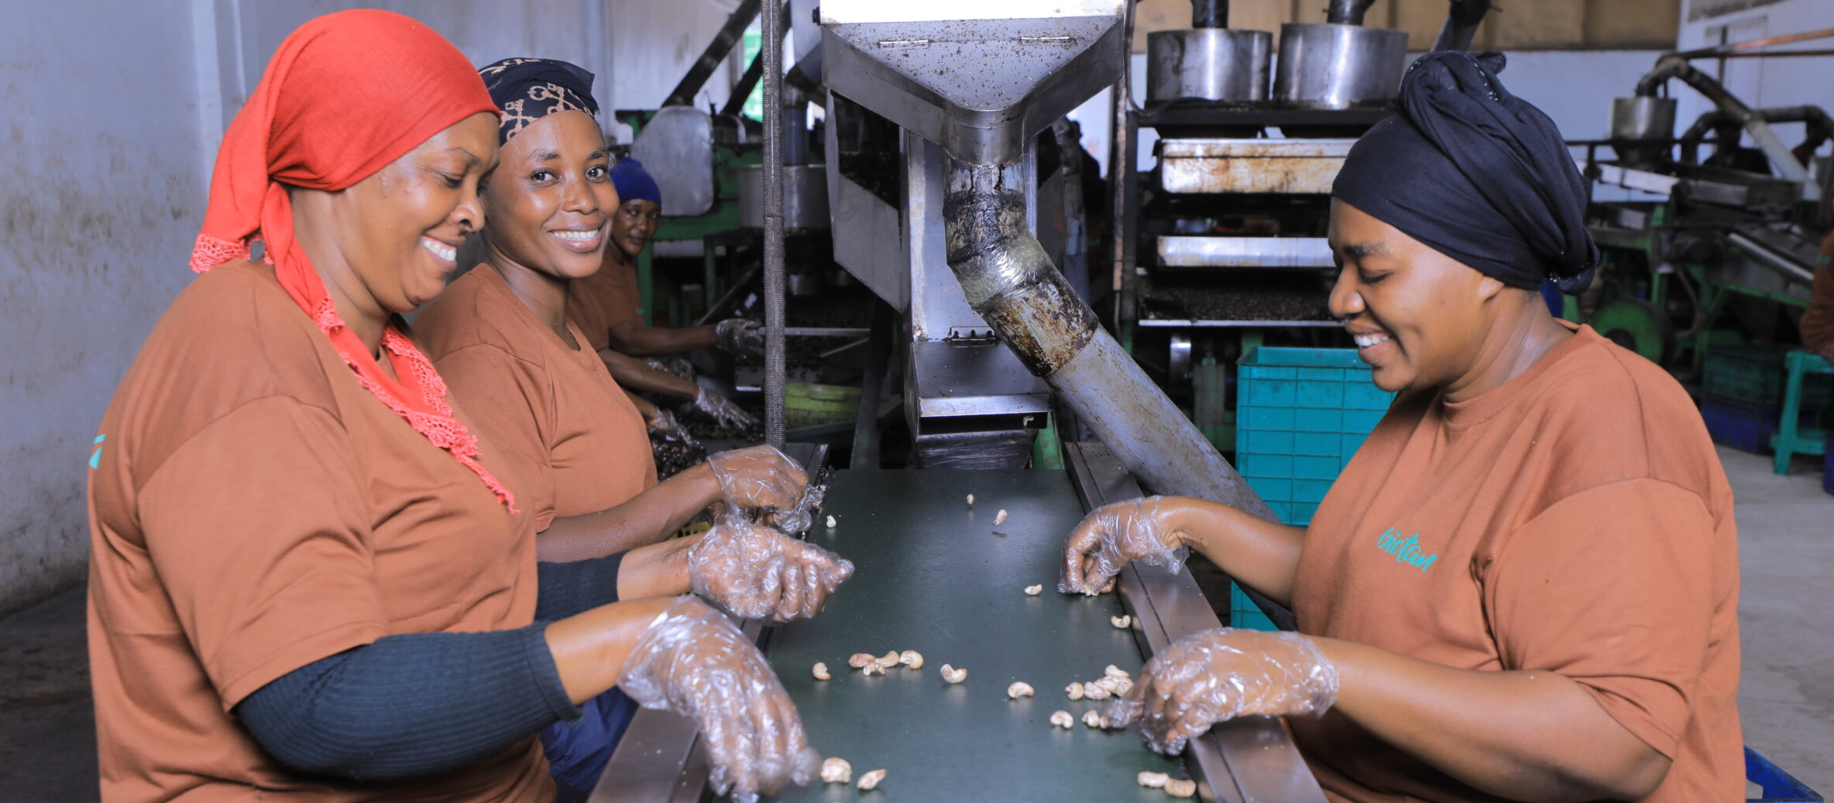
BioTan
Organic Cashew Nuts from Tanzania

Slide 27
Synergies between ADA and OeEB
ADA grant: €400 000
Started in 2017, now 2nd phase
Aim is to triple the quantity of processed raw organic cashew nuts and expand the value chain
Mainly funded operational costs, working capital, support for farmers, organic farming and certification
OeEB loan: €800 000
Started in 2022
African-Austrian SME Investment Facility complements ADA’s BP Program
Invest in the company’s infrastructure (land, warehouse and additional machinery for processing)

Slide 28
Thank you for your attention!
gottfried.traxler@ada.gv.at

