Slide 1
Update on Norad’s private sector work
Washington dc, 6 june 2024
Norwegian Agency for Development Cooperation

Slide 2
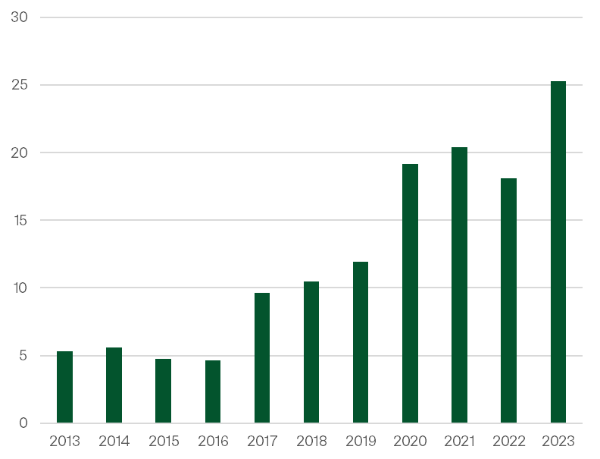
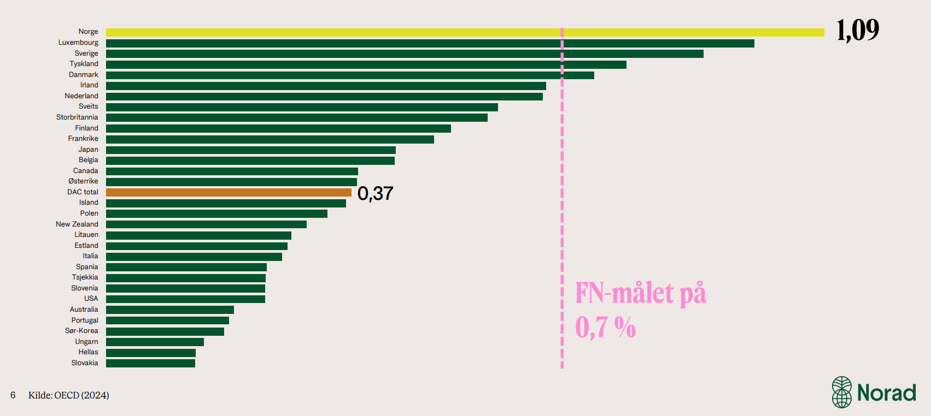
The bigger pickture
Norad annual budget (Billion NOK)

Slide 3
2024: Norads budget for PSD and trade

Slide 4
From separate thematic area – to integration

Slide 5
Current focus and new initiatives
Call for proposals - Framework conditions for private sector:
Incubators and accelerators in the blue and green space
First loss for local banks and financial institutions

Slide 6
New guarantee mechanism for renewable energy
Approved by parliament end 2023
Norway’s AAA-rating can be used to enable/unlock more investments in frontier markets
5bn NOK for initial phase
65 per cent with multilateral development banks
Max 30 per cent in low-income countries
Loss provision of 750m NOK
Open in terms of type of guarantee (forex, political etc) and recipient (SME, portfolio, bank, fund)
Premiums can be subsidized

Slide 7
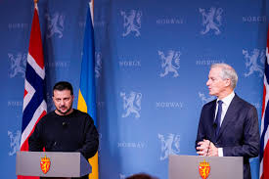
The Nansen program for Ukraine –PSD window
Enterprise development – SME’s
First loss capital
Framework conditions and access to finance for SME’s.

Slide 8
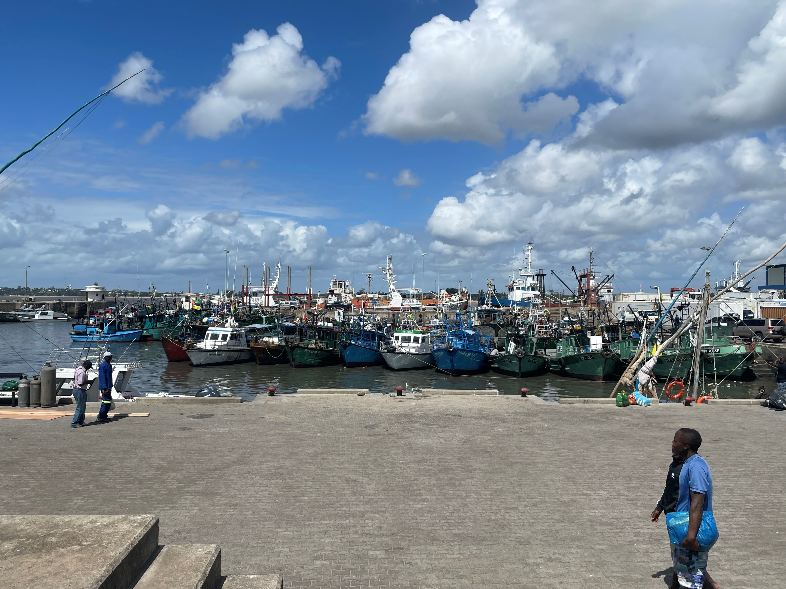
New portifolio on jobbs creation
Work in progress
A clear geographic focus on selected countries in Eastern- and Western Africa

