Slide 1


Small matters
ILO update. DCED annual meeting 2024
Merten Sievers
MSME Branch
ILO – Enterprises Department
sievers@ilo.org

Slide 2

Employment in “small economic units”

Slide 3
Sustainable Enterprises, Productivity and Just Transition – Areas of work
Cooperatives and SSE
Multinational Enterprises
Social Finance
MSME Branch:
  Business Environment, Productivity and Working Conditions
  Enterprise Formalization and WED
  Entrepreneurship promotion
  Market Systems Development
  Inclusive Market Systems
  Greening SMEs
Global team at HQ: 65 staff
14 Enterprise and SME specialists in Decent Work teams and ILO country offices
30 International and 120 national staff in projects (aprox)
250 mi project portfolio (aprox)

Slide 4

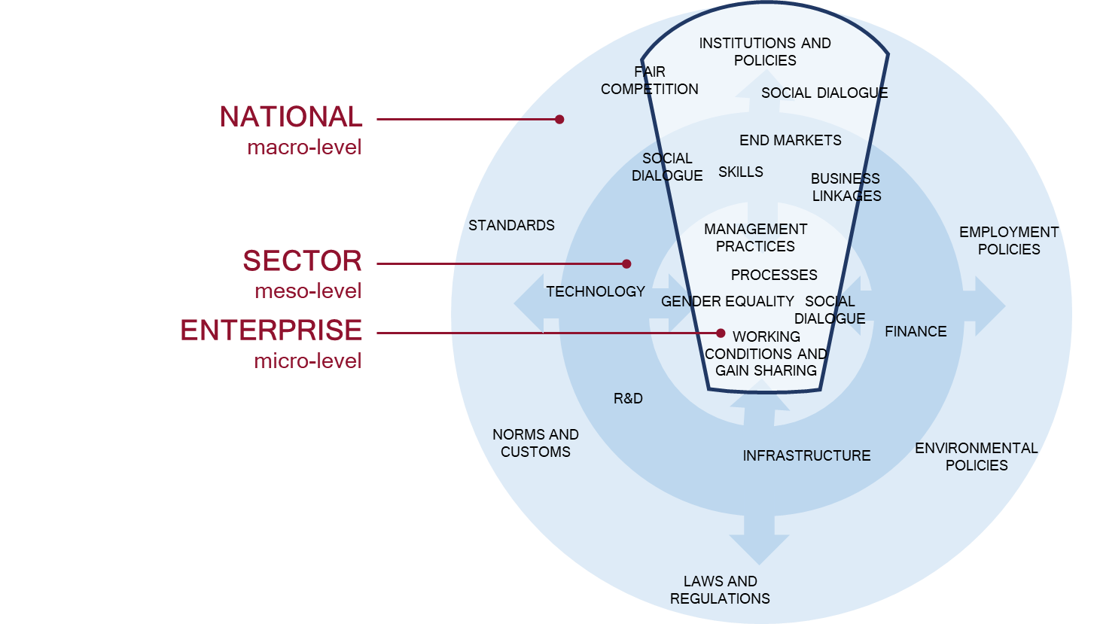
1. Productivity and Working Conditions: Productivity Ecosystems
Global Project: SECO and NORAD
OUTCOMES
FINA OUTCOMES
Notes:
Why do we care about training on productivity and working conditions?
Small and medium-sized enterprises account for two-thirds of all jobs worldwide. However, they are far less productive than larger firms and low levels of productivity often coexist with poor working conditions.
Especially in emerging economies, SMEs struggle to deliver the required product quantities at consistent quality meeting international product standards. Therefore, they are less likely to participate in national and global supply chains.
SCORE focuses on factors within enterprises that contribute to low productivity such as outdated management practices or low skilled labour. Low productivity hampers industrialization and job creation.
What do we offer?
SCORE is a modular training and in-factory consulting programme for medium sized companies producing for large domestic or international buyers. The program focuses on the manufacturing sector in emerging economies and is usually offered through government agencies or industry associations. The five modules of SCORE offer support on workplace cooperation, quality management, cleaner production, human resource management, and occupational safety and health.
SCORE aims at integrating initiatives to improve working conditions and to upgrade core management practices with the ultimate goal of improved firm productivity and better jobs.

Slide 5




For more information visit http://www.ilo.org/ef

Slide 6
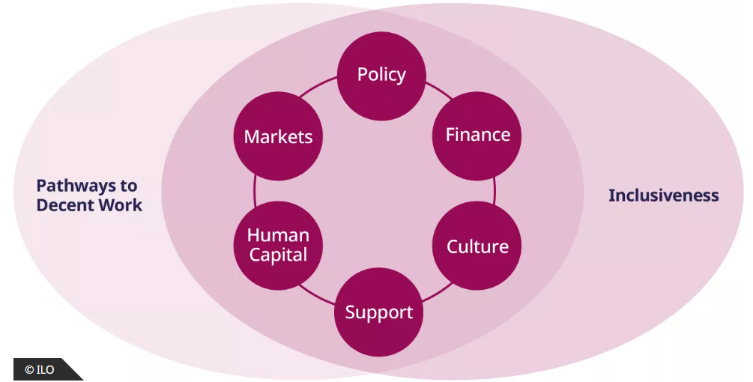
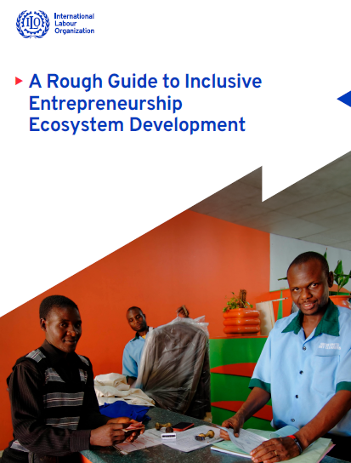


3. Entrepreneurship Development
Notes:
Why do we care about women and women's entrepreneurship?
Women represent half of the world's population, yet they own between one third and one forth of all formal businesses;
If women participated in the economy equally to men, it would add up to US$28 trillion, or 26%, to annual global GDP
Research finds that standard entrepreneurship development interventions are not having the same impact on women as they do on men, some of the reasons are
Women are more often concentrated in low-value sectors
Women start with fewer resources: capital, human/skills and networks
Women spend a higher percentage of their time on family responsibilities (globally women spend 4h47 minutes compared to men's 1h30)
Yet women are also found to reinvest 90% of their income to support the health, nutrition and education of their families. Thus, supporting women to be more productive entrepreneurs helps not only themselves but communities at large through their multiplier effects
What are we offering?
The Women's Entrepreneurship Development programme provides training and support services for women who wish to start and run their businesses. It does so with a gender perspective that contributes to their empowerment.
For over 15 years ILO WED has worked with service providers to better understand their current service provision to women, identify practical ways in which to improve, and equip them with gender-sensitive business management training packages. In addition, ILO WED periodically undertakes applied research on obstacles and specific needs of female entrepreneurs to support national policy dialogue and programmes.

Slide 7

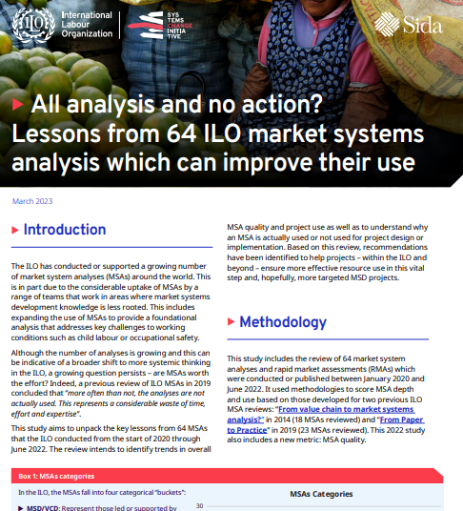

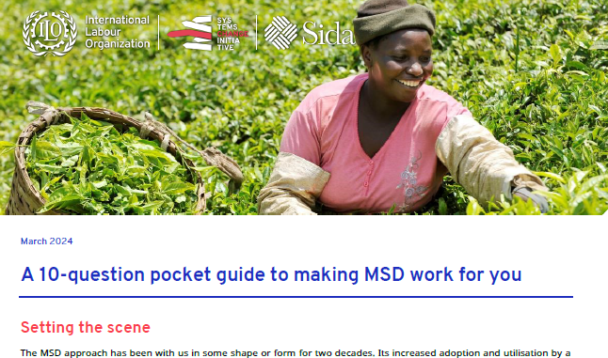
4. Market Systems and Decent Work
www.ilo.org/sci
Funded by Sida

Slide 8


5. MSD and the Hum-Dev nexus
Approach to Inclusive Market Systems
Lebanon, Egypt, Kenya, Uganda, Ethiopia, Sudan (all PROSPECTS – Dutch MoFA) Lebanon (Sida); Kenya (US State), Niger (US State), Nepal (UNHCR); Bangladesh (GAC); Pakistan (UNHCR)
Notes:
Why do we care about training on productivity and working conditions?
Small and medium-sized enterprises account for two-thirds of all jobs worldwide. However, they are far less productive than larger firms and low levels of productivity often coexist with poor working conditions.
Especially in emerging economies, SMEs struggle to deliver the required product quantities at consistent quality meeting international product standards. Therefore, they are less likely to participate in national and global supply chains.
SCORE focuses on factors within enterprises that contribute to low productivity such as outdated management practices or low skilled labour. Low productivity hampers industrialization and job creation.
What do we offer?
SCORE is a modular training and in-factory consulting programme for medium sized companies producing for large domestic or international buyers. The program focuses on the manufacturing sector in emerging economies and is usually offered through government agencies or industry associations. The five modules of SCORE offer support on workplace cooperation, quality management, cleaner production, human resource management, and occupational safety and health.
SCORE aims at integrating initiatives to improve working conditions and to upgrade core management practices with the ultimate goal of improved firm productivity and better jobs.

Slide 9

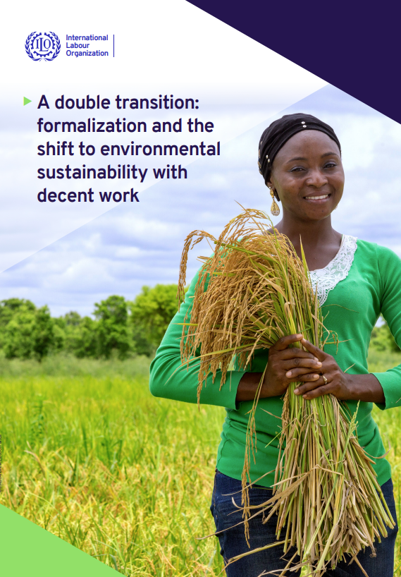


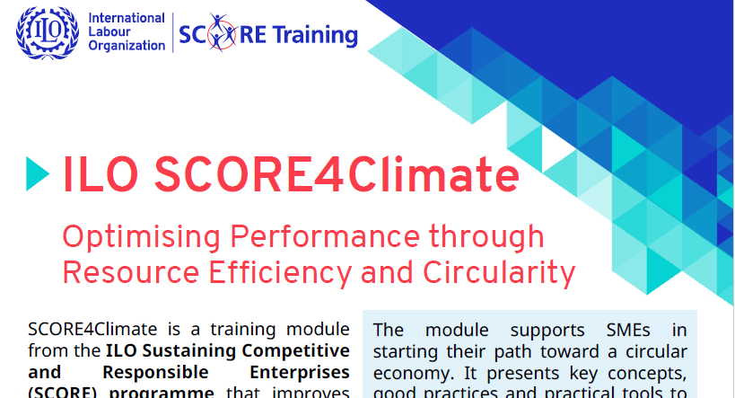
6. Greening SMEs
OUTCOMES
Notes:
Why do we care about training on productivity and working conditions?
Small and medium-sized enterprises account for two-thirds of all jobs worldwide. However, they are far less productive than larger firms and low levels of productivity often coexist with poor working conditions.
Especially in emerging economies, SMEs struggle to deliver the required product quantities at consistent quality meeting international product standards. Therefore, they are less likely to participate in national and global supply chains.
SCORE focuses on factors within enterprises that contribute to low productivity such as outdated management practices or low skilled labour. Low productivity hampers industrialization and job creation.
What do we offer?
SCORE is a modular training and in-factory consulting programme for medium sized companies producing for large domestic or international buyers. The program focuses on the manufacturing sector in emerging economies and is usually offered through government agencies or industry associations. The five modules of SCORE offer support on workplace cooperation, quality management, cleaner production, human resource management, and occupational safety and health.
SCORE aims at integrating initiatives to improve working conditions and to upgrade core management practices with the ultimate goal of improved firm productivity and better jobs.

