Slide 1
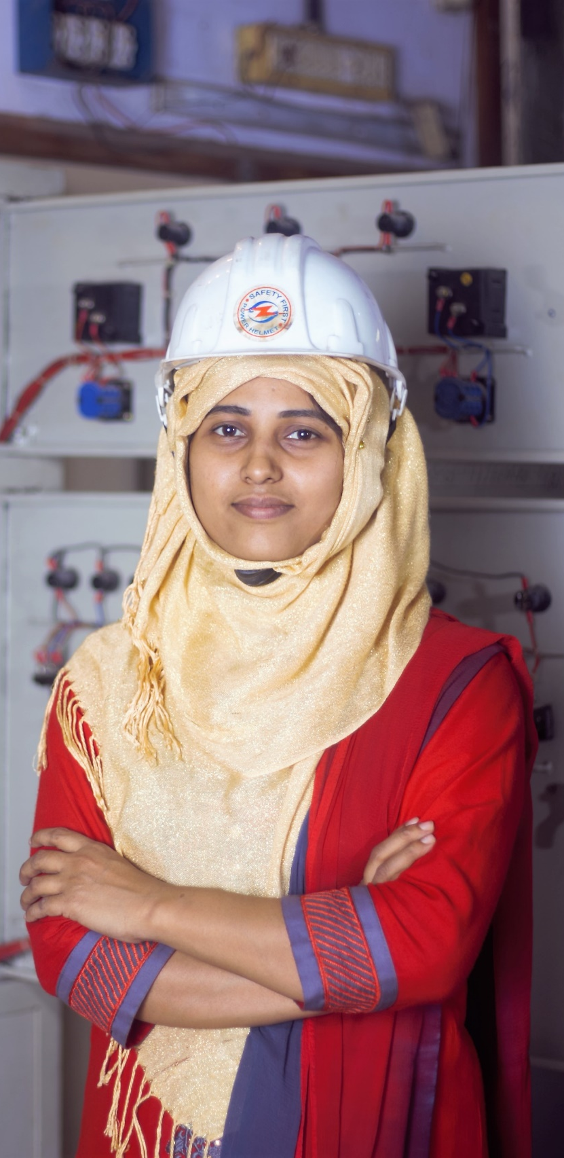
SDC Member Update DCED Annual Meeting
June 2024
sektionwirtschaftbildung@eda.admin.ch

Slide 2
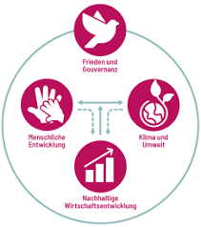
Institutional Updates
New International Cooperation Bill 2025-28 approved by Federal Council two weeks ago. Will go to parliament in the fall.
Four overarching objectives:
  Save lives and promote access to basic services
  Promote sustainable economic development and contribute to the creation of decent jobs
  Promote environmentally friendly and resilient development
  Support peace and human rights and strengthen democracy and the rule of law

Slide 3
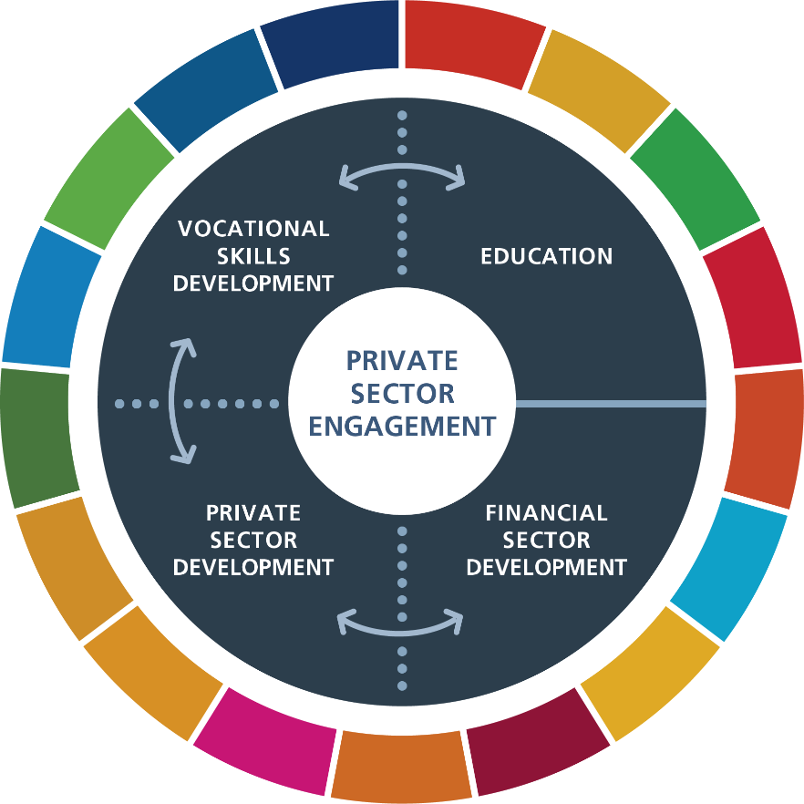
Institutional Updates 2
Reorganization of SDC in 2022
We are part of Education and Economy Section covering Basic Education, Vocational Skills and Development, Financial Sector Development, Private Sector Development and Private Sector Engagement
Finalizing new Programmatic Framework for 2025 – 28.

Slide 4
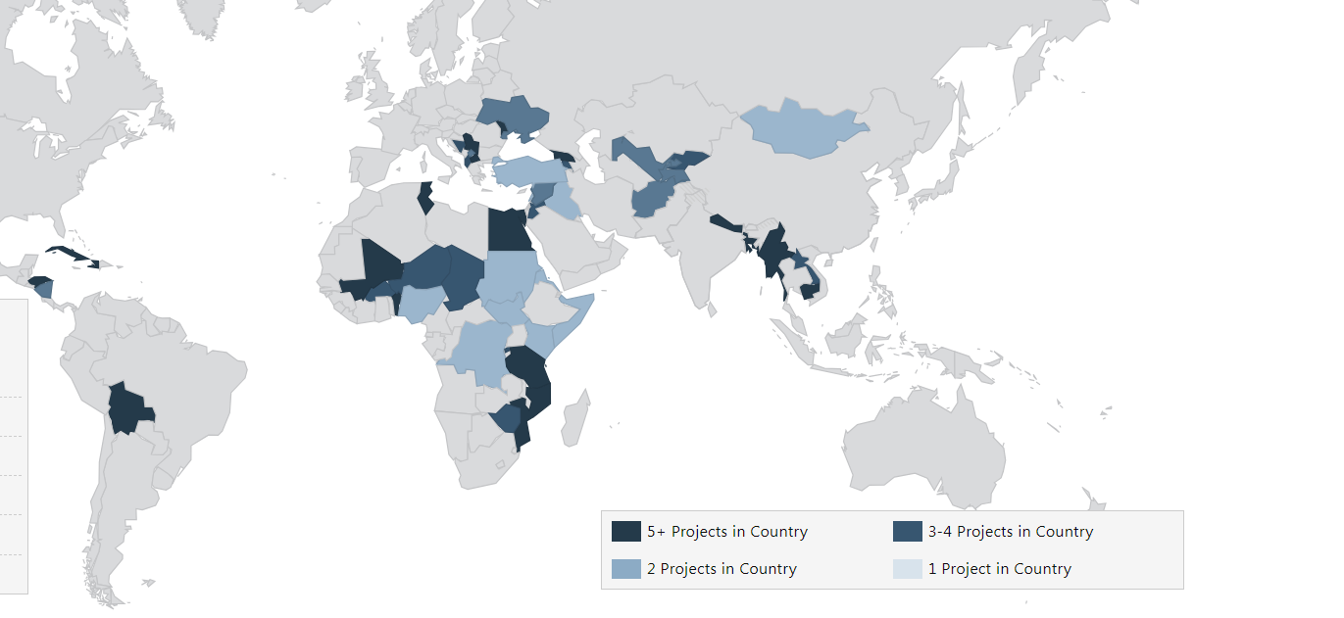
Programmatic Updates: PSD Project Overview
MSD and LED as main approached
Well establsihed practice at SDC, PSD proejcts in almost all priority countries.
Recommended to use DCED Standard in M+E setup.

Slide 5
Programmatic Update PSD
Workstream on Inclusive Green Economy.
  Papers on Circular Economy, defining IGE, Green Finance
  Regional workshops in Asia and Balkans on operationalizing IGE
New global project to promote Social and Impact Enterprises
    Co-creation process started

Slide 6
Programmatic Update PSE
Completed second direct investment into a structured fund: N3F Fund focused on nutrition in Africa. Currently workin on third investment.
SDG Impact Finance Initaitve fully operational: platform to de-risk impact investments
Impact linked Finance Fund for Gender Inclusive Fintech fully operational, expanded into northern Latin America
Launched ILF Collaborative to scale up impact linked finance

Slide 7

Thank you!

