Slide 1


Switzerland’s International Cooperation Strategy 2025-28: What’s New for SECO?
Criteria
Priorities
Countries
Budget
Needs
Added Value
Interests
Private Sector
Public Institutions
Infrastructure and Urban Development
13 with entry in
14% = 1.58 billion
SECO
11.27
billion
and exit in

Slide 2
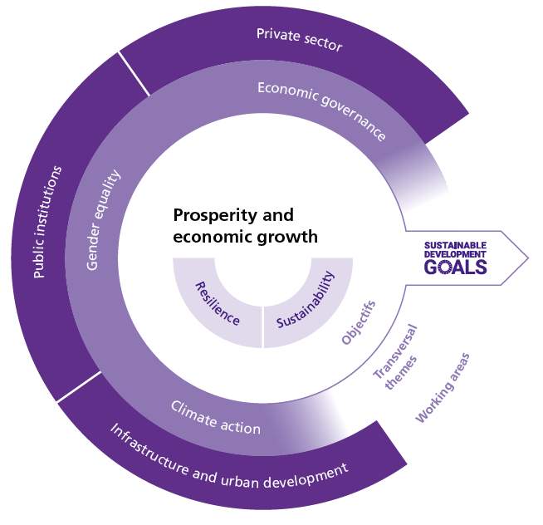
Switzerland’s International Cooperation Strategy 2025-28: What’s New for SECO?

Slide 3


SDG Impact Finance Initiative
Catalyzing private capital for impact

Slide 4

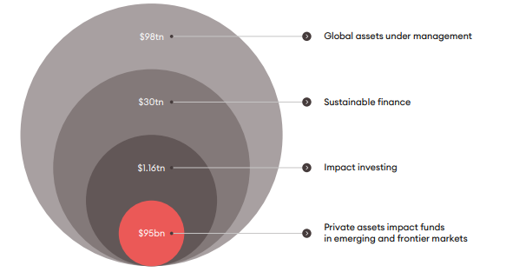
Scaling Impact Investing
SIFI’s mission is to mobilize CHF 1 billion in private investment to help deliver the SDGs by mainstreaming impact investing in developing economies.
How? We leverage public and philanthropic funds to bring more impact financing products to the market, support them to become investment ready and to scale by lowering the risks of private investors. Our end goal: to help shift social and environmental impact from niche to scale, through the mobilization of greater private sector investment.
Source: Tameo, Private Asset Impact Fund report 2023

Slide 5
Our solution
Our journey takes three critical pathways to achieve impact and drive positive change.
Sparking innovation 2 CfPs per year - < USD 2 m each
kick-starting promising, impactful ideas
traditional and repayable grants
feasibility studies, proof of concept and expansion grants.
Fuelling growth and scale
2 CfPs per year - USD 5 m each
Ensuring good financing solution thrive
Attracting private capital through first-loss investments/guarantees.
May include technical assistance and payment for outcomes.
Shaping the ecosystem
Stimulating the environment for impact investing in Switzerland and beyond
Framework conditions: policy, tax, and regulation
Correcting misperception of risks
Exploring liquidity mechanisms
1
2
3

Slide 6
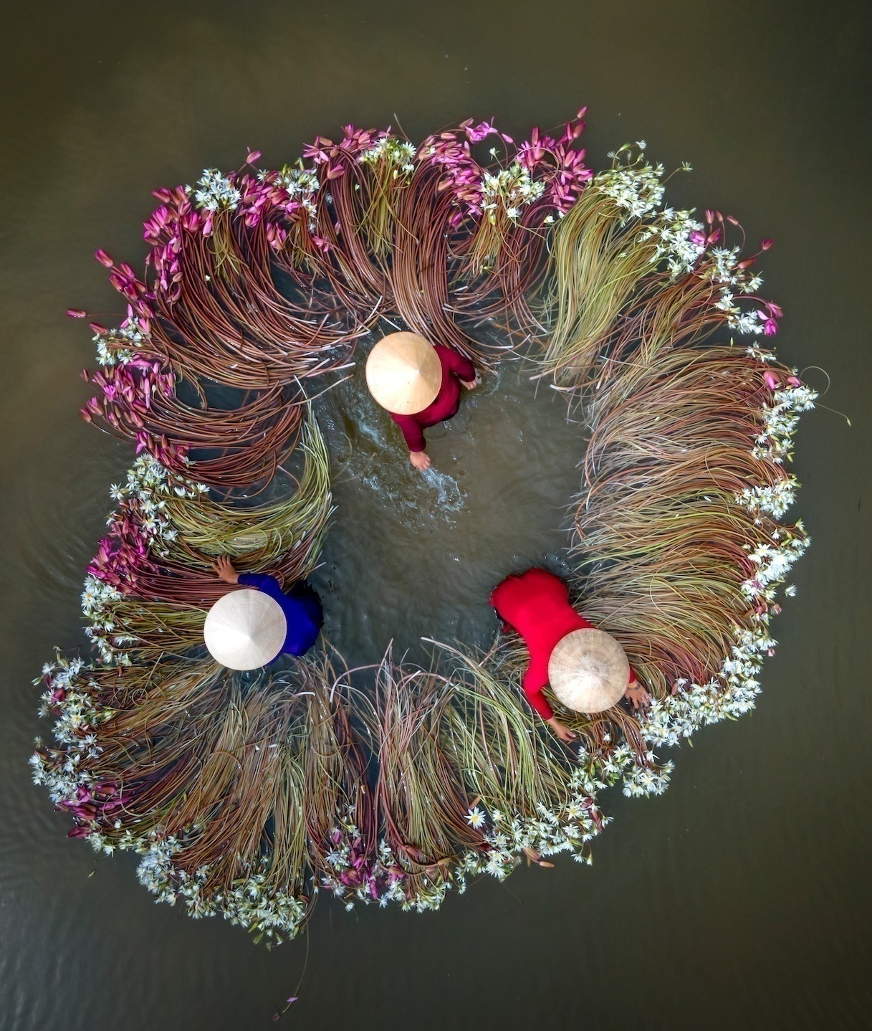



Our partners
From the start, public-private-philantropic sector partnership remains at the heart of our vision and business model. Only collectively, we can bridge the global funding gap in achieving the SDGs. SIFI’s members’ contributions fuel innovative solutions, broaden our knowledge network, and influence our direction.

Slide 7






Guiding principles
Our work is governed by the following guiding principles
Scalability: We're looking for initiatives that show promise in attracting significant private investment. | Self-sustainability: The projects should have the potential to stand on their own feet financially over time. | Additionality: The proposed projects should be unique in that they can't find similar funding elsewhere.
Fair competition: We avoid backing projects that would unfairly distort competition between companies. | Direct benefits: The ultimate winners should be in countries that are eligible for official development assistance. | Impact on SDGs: We need to see that the initiatives have a clear and measurable impact on achieving the Sustainable Development Goals.
Collaboration: We value and promote collaboration between the private, public, and philantropic sectors.

Slide 8
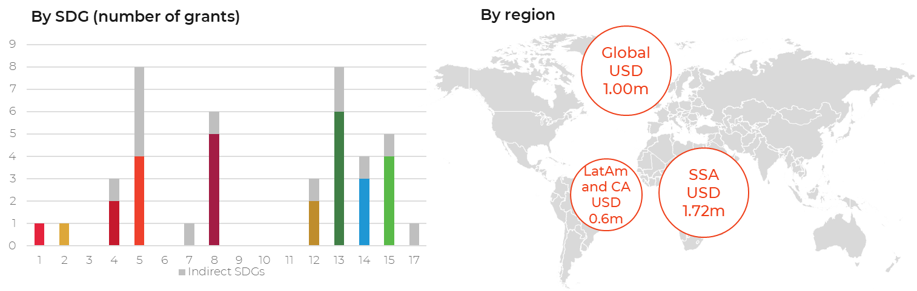
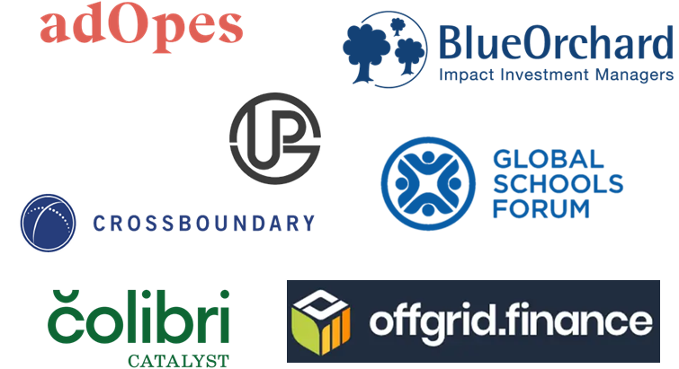
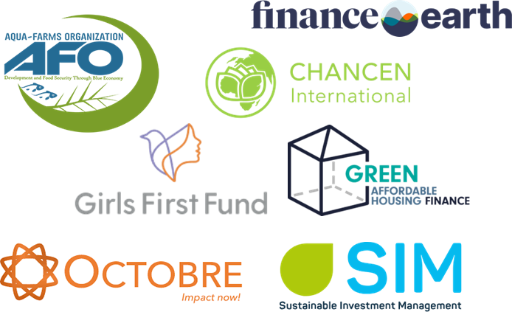










Our active portfolio
Innovation Window
Calls | 2 + ongoing CfP | Active grants | 14 | Total value | USD 3.32 million
Our grantees
Product Window
Calls | 1+ongoing CfP | N of investees | 3 | Total value | USD 5 million
Target SDGs
Regions
Sub-Saharan Africa
Global

Slide 9
Meeting market demands – application intake
Innovation Window
Product Window
CfP | Funding | Applica-tions received | Eligible | Winners
C1 | USD 1.52 m | 121 | 76 | 7
C2 | USD 1.80 m | 167 | 33 | 7
C3 | < USD 2.00 m | 266 | 23 (shortlisted) | Up to 5
CfP | Funding | Applica-tions received | Eligible | Winners
W2C1 | USD 5 m | 43 | 5 (shortlisted) | 3
Outlook for 2024
Currently selecting winners under W1C3 targeting SDG 3 (Good Health and Well-being), 13 (Climate action), and 16 (Peace, justice and strong institutions)
Next CfP – September 2024
SIFI announced the first winners under W2C1 focussing on Nature solutions and Climate Change intersection (SDG 2, 7, 11, 13,14,15)
Next CfP – April 2024 “Building Resilient Societies and Developing Human Capital»
2 CfPs p.a.: one focusing on social issues and one on climate

Slide 10

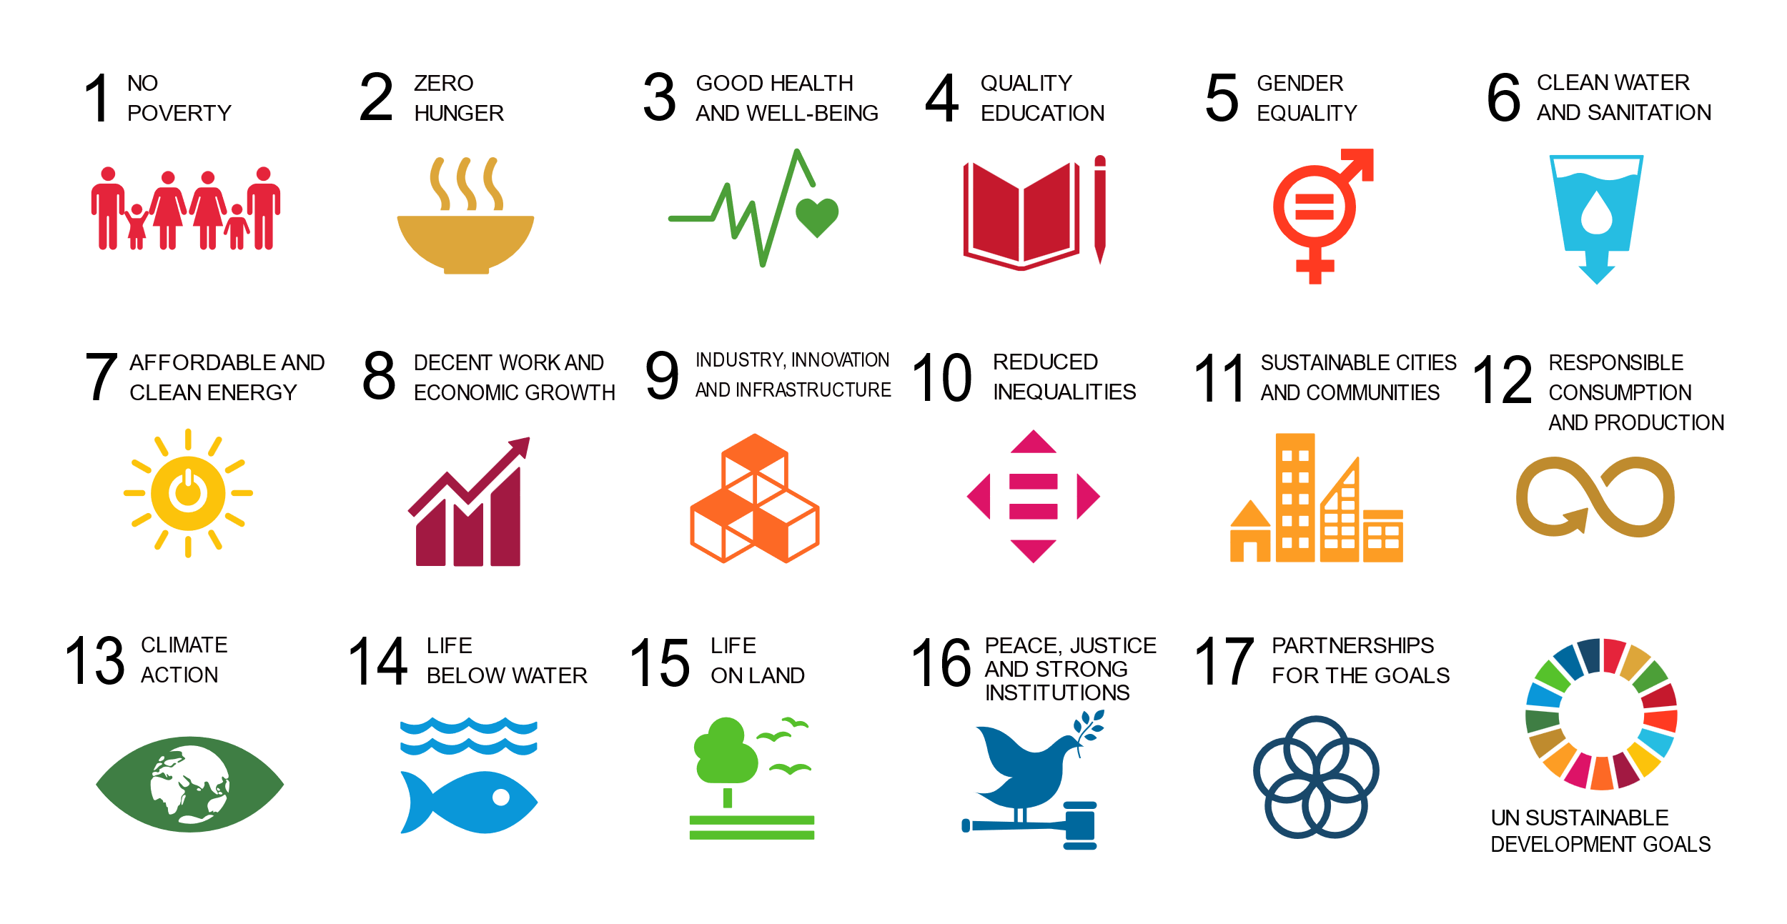

Innovation Window
Grant type
Expansion
Grant Amount
USD 200k
Cycle
1
SDGs targeted
Geographical Focus
Sub-Saharan Africa
Description
AdOpes Ltd. operates a Microleasing platform in East Africa, specifically developed and tested over 15 years in Kenya, Rwanda, Tanzania, and Uganda. The platform primarily serves smallholder farmers and microenterprises by providing productive assets through microleases. These assets are essential for mechanizing and professionalizing agricultural and business activities, thereby leading to larger yields, increased income, and enhanced net worth for the beneficiaries.
The innovation at the heart of AdOpes' model is the “Microleasing Fund,” a pioneering investment vehicle designed to offer capital specifically for asset financing tailored to the needs of its target demographic. This model addresses the critical gap in traditional financial systems that often exclude smallholder farmers and microenterprises due to their inability to provide collateral, small ticket sizes, and the misalignment of loan products with the agricultural sector's needs.
Find out more

Slide 11

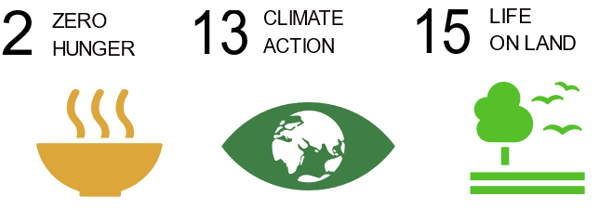

Product Window –
first winners
Fund Name
Sustainable Land Fund 2 (SLF2)
Form of SIFI Capital
First-Loss Equity
Asset Class
Debt, mezzanine, and equity (majority debt instruments)
Investment Amount
CHF 2 million
Mirova SLF2 focuses on reversing the adverse effects of deforestation and land degradation through sustainable forestry and agriculture, directly impacting climate resilience and biodiversity.
Fund Name
AGRI3 Fund
Form of SIFI Capital
First-Loss Equity
Asset Class
Partial Guarantees
Investment Amount
CHF 2 million
Cardano Development AGRI3 Fund is making strides towards sustainable agricultural practices and forest conservation, aiming to mobilize finance for projects that enhance rural livelihoods and protect natural forests.
Fund Name
Energy Go Getters Fund (EGGF)
Form of SIFI Capital
First-Loss Equity
Asset Class
Private Equity
Investment Amount
CHF 1 million
On.Capital & SouthBridge Investments EGGF is addressing critical energy access challenges in Sub-Saharan Africa by investing in clean electricity solutions for 25 million people, using innovative technologies and business models.

Slide 12

Mirova Sustainable Land Fund 2
Mirova MSLF 2
USD 300-400m
Senior Tranche (85%)
1.
Commercial Capital
Senior Investors (capital repayment + 5% preferred return)
Private institutional investors, DFIs, MDBs, etc.
Seniority
2.
Junior Investors (capital repayment + 1% preferred return)
3.
Excess Return Split (80% Limited Partners & 20 % General Partners)
Junior Tranche (15%)
Concessional Capital
CHF 2 million First-Loss Equity

Slide 13



Achieving scale – our vision
SIFI acts as an aggregator of public and philanthropic funds
We pool public and philanthropic capital to support shared objectives. We efficiently deploy grants using an existing platform designed to manage traditional grants and investments to catalyze private capital for underfunded SDGs and geographies. The independent legal structure ensures that there is no conflict of interest or potential market disruption compared to a private sector actor.
SIFI is a blended finance model ready to scale
SIFI’s comprehensive structure allows funders to support a wide range of grantees and investees across all development stages of the project, from idea generation to scale. Product Window will become the core of our operations. Our recent fundings have shown that to efficiently respond to market needs, we need to multiply our investments, and consolidate blended finance capital from different donors into a single agile platform.
SIFI’s organizational structure supports economically viable projects
We select multiple grantees and investees under each call through a competitive and structured process. The decision-making is supported by an independent professional investment committee, allowing the selection of commercially viable initiatives where SIFI’s funding will be additional and catalytic.

Slide 14
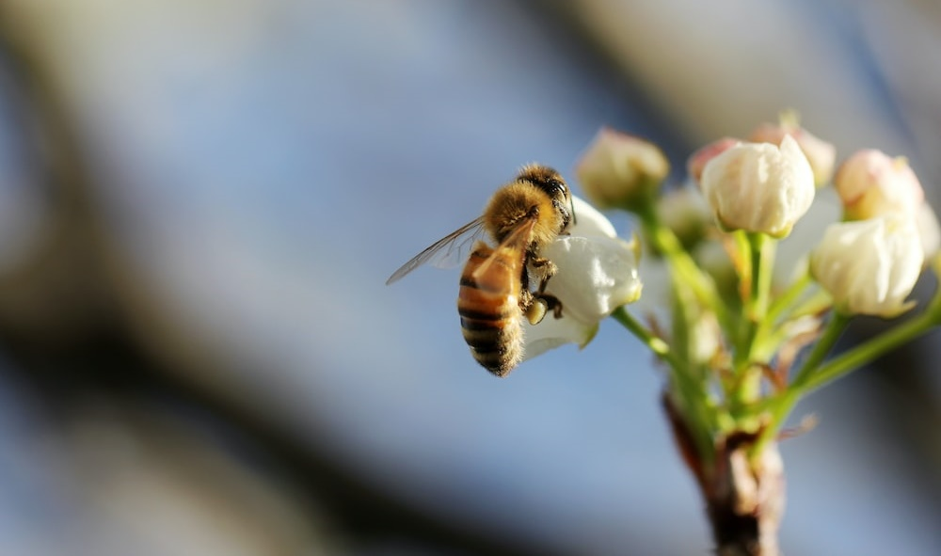

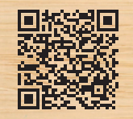
Contact us
Guillaume Bonnel
Chief Executive Officer
gb@sdgimpactfinance.org
+41 79 353 34 80
www.sdgimpactfinance.org

Slide 15

Delivery model: key functions
Funding
Governance
Advisory
Management
Delivery partners
Direct recipients
Donors
General Assembly
Advisory Council
Exec Board
Committees
Grantees
Executive Team
Service Providers
Investees
Knowledge providers
Reporting
Eligible for membership of General Assembly
Eligible for election to Advisory Council
Major donors eligible for Executive Board
General Assembly approves annual report and financial accounts, annual work plan & budget
Advisory Council advises Board, promotes wider collaboration and ownership
Executive Board provides strategic direction, approves executive decisions
Executive comprises a CEO and Secretariat responsible for operational management
Investment & Selection Committees recommend applicants for grants & investments
Service providers support implementation across the funding windows
Grantees/investees may be asset or investment managers, funds, NGOs
Knowledge partners could include universities, networks or associations

Slide 16
Key milestones
Jan 2024 New partnership with Luxembourg announced at Davos
Lena Katharina Gerdes joins as Program Manager
Dec 2021 Launched at Building Bridges
Dec 2022 Four founding partners commit CHF 31.6 million in funding
Mar 2022 1st call for proposals (CfP) under Innovation Window
Sep 2022 Josien Sluijs
appointed
Independent
Executive President
Jul 2023 Guillaume Bonnel appointed CEO
Apr 2024
3 winners
announced
under
Product Window
Dec 2023 Catherine Bukhal joins as Donor Relations manager
Jul 2022 Granted tax exempt status
Mar 2023 2nd CfP under Innovation
Window
Jan 2022 Legally registered as a Swiss association
Nov 2022 Seven grants worth
CHF 1.52 million
awarded
Oct 2023 Seven grants worth
CHF 1.8 million
awarded
1st Product Window
CfP launched for total amount of up to CHF 5 million
Feb 2024 3d CfP under
Innovation Window

Slide 17
Membership of governance bodies
General Assembly
UBS Optimus Foundation
Ministry of Finance, Luxembourg
Advisory Council
Liliana de Sá Kirchknopf (SECO)
Sabine Döbeli (Swiss Sustainable Finance)
Diepak Elmer (SDC)
Dean Hand (GIIN)
Laurent Matile (Alliance Sud)
Daniel Steenkamp (Bertha Centre for Social Innovation and Entrepreneurship)
Naina Subberwal Batra (Asian Venture Philanthropy Network)
Executive Board
Josien Sluijs, (Independent Executive President)
Maya Ziswiler (UBS Optimus Foundation)
Jennifer de Nijs (Ministry of Finance, Luxembourg)
Executive Team
Guillaume Bonnel (CEO)
Lena-Katharina Gerdes (Program Manager)
Catherine Bukhal (Donor Relations)
Investment Committee members
Sebastien Boye (CEO, I&P)
Amitabh Brar (impact investment advisory)
Thelma Ekiyor (Managing Partner, SME.NG)
Lily Han (Director, Rockefeller Foundation)
Dorothée Herr* (Senior Associate, NatureMarkets)
Bart van Eyk (Managing Director, VP Capital)
Lauren Verstandig* (Managing Director, NatureVest/TNC)
* from design call 2
Service Providers
Convergence (Window 1)
Broadpeak (Window 2)
Impact Capital Advisory (results framework)

